Slide 1

Satellite Tracking Microwave Ground Station (STMGS)
Team Members: Clay Edwards Christian Ogburn Jared O’Shea Jusefs Saade Jordan West Ian Wolfe
Product Owner: Dr. Eduardo Rojas

Slide 2
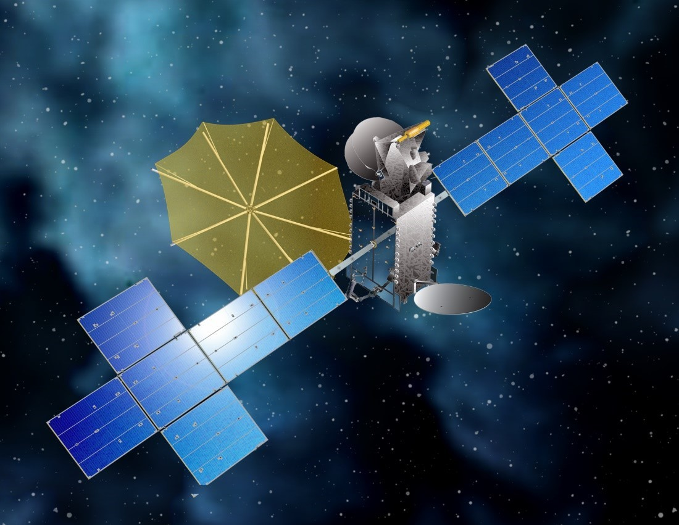
Introduction
Ground stations are a key part in satellite communications
Global Connectivity
Emergency Response
Navigation and Mapping
Commercial Applications (such as our STMGS)
Space Exploration
Sirius XM SXM-8 Satellite

Slide 3
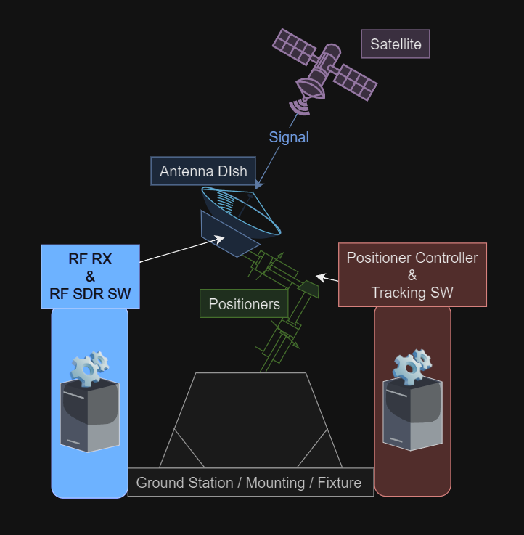
Summary of Project
Our mission is to track and receive signals from an S-Band frequency satellite.
The system is composed of six subsystems: A positioner, tracking software, antenna, RF block, software-defined radio (SDR), and SDR software
The focus of this project has been designing an RF block, receiving and recording incoming signals, and accurately tracking a satellite

Slide 4

Customer Needs
Live GUI for satellite tracking software
Live SDR signal viewing & recording
RF block design
Filter
Phase Polarizer
Power Combiner
S-Band satellite focus (≈ 2.330 GHz)
Use available materials from WiDE Lab
Demodulation

Slide 5
Design Requirements Overview
Hardware
SDR operates in S-Band
S-band dish antenna
RF block
Filter - (2.2GHz - 2.5GHz)
Phase Polarizer - (±90°± 1°)
Power Combiner - (s-parameter ≤ -20 dB)
360° Azimuth / 180° Elevation
Manual/Automatic positioning
Software
Visualize signal waveform
Record signal in .wav
Allow tuning of SDR settings
Live GUI of satellite and station location
Allow new satellite TLE’s
Maintain alignment within 5°
Communication with controller

Slide 6
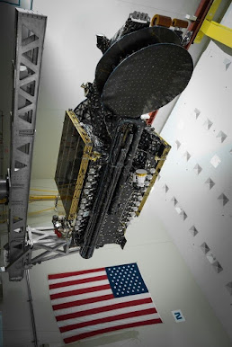
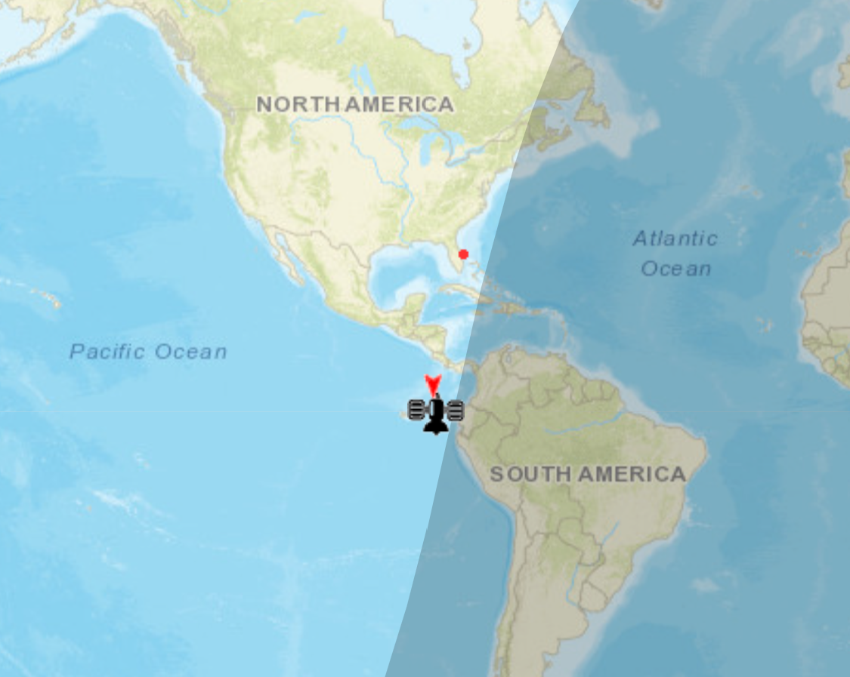
Satellite Choice
SXM 8: Sirius XM satellite
Operating Frequency: 2.3231 GHz (S-Band)
Geosynchronous Orbit
From Daytona Beach:
~55.5° Elevation
~188.5° Azimuth

Slide 7

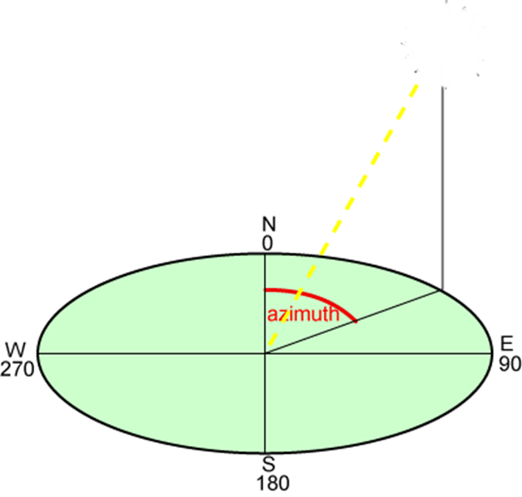
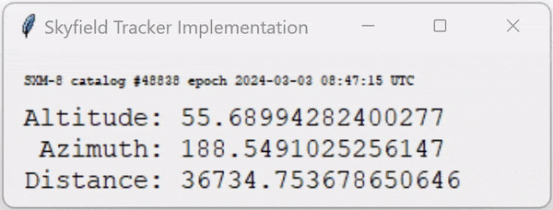
Tracking Software
Tracking Software outputs azimuth and altitude (elevation) to computer controller
Difficult to find compatible tracking software for older WiDE lab equipment
SatPC32 - satellite tracking and positioner control

Slide 8
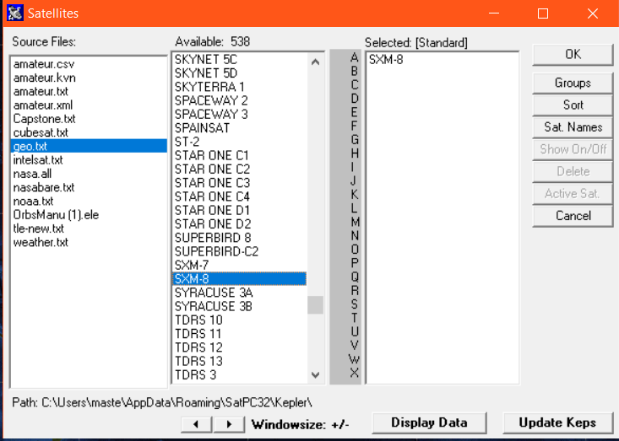
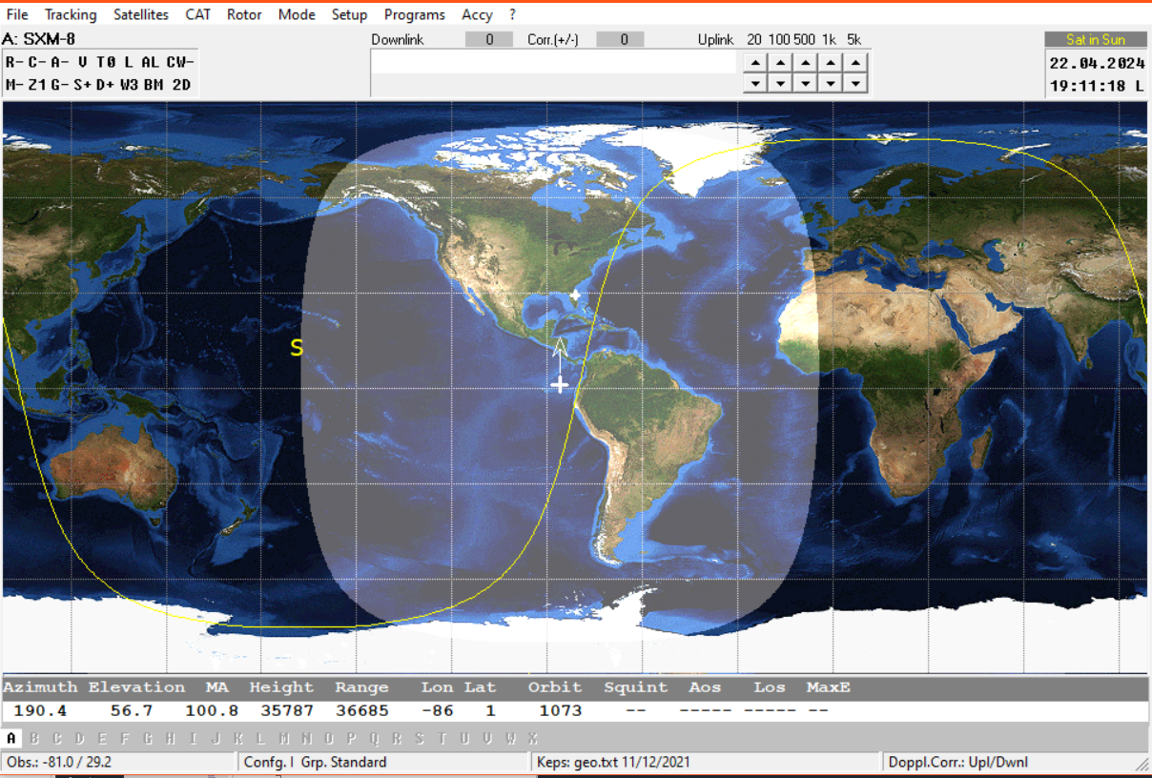
SatPC32
Accurate satellite tracking capabilities
Ability to manually add in new satellites
Live satellite map GUI
Compatible with our Yaesu GS-232 computer controller
SXM-8
User Location
SXM-8
Azimuth and Elevation Outputs

Slide 9
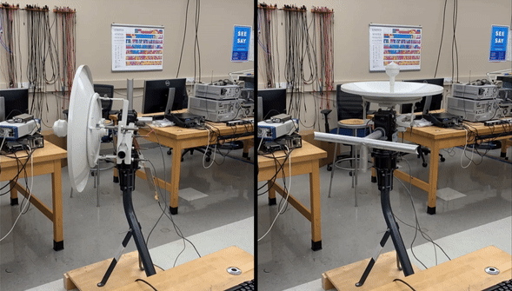
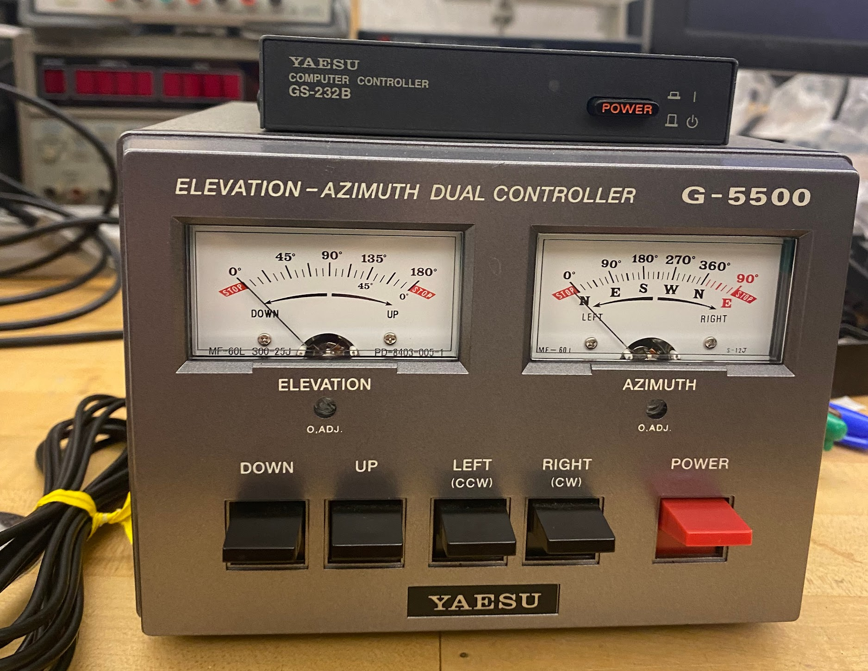
Tracking Hardware
Requirement for full 180° elevation & 360° azimuth
No issues when moving through full motion
Positioner controlled by G-5500
G-5500 controlled by GS-232B computer controller

Slide 10
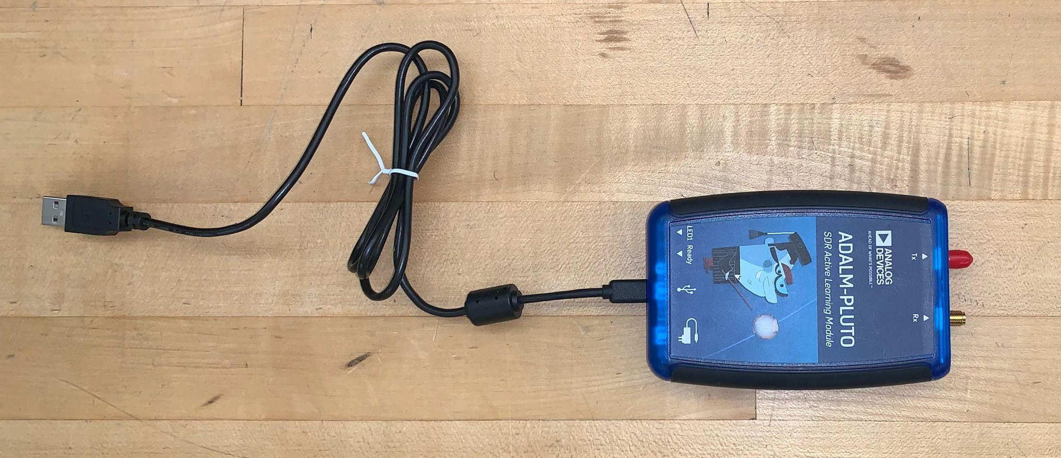
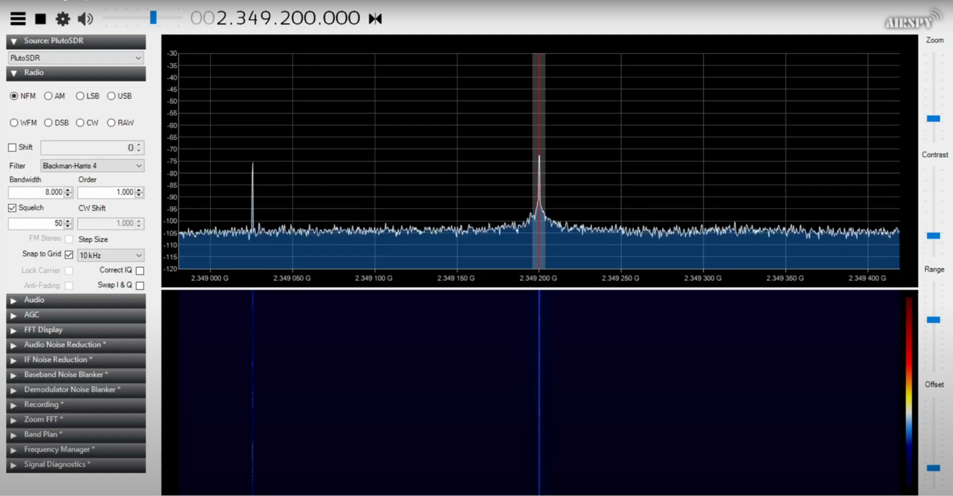
SDR Hardware/Software
PlutoSDR - hardware range: 325 MHz to 3.8 GHz
Software used to adjust SDR settings and record signals
SDR# - Good UI with audio and baseband recording features
.wav file output used for demodulation, can also be direct from source

Slide 11
RF Block Design
Purpose: Align phase and combine signals, filter unwanted signals, amplify desired signals
Components:
Two Microstrip T-Lines for Phase Shift
Combiner (Centric RF CS0218S-2)
Bandpass Filter (6th-Order, Butterworth, Coupled-Line)
Low Noise Amplifier (Mini-Circuits ZX80-P103LN+)
RF Block
SDR
Incoming Signal
LNA
Circular Polarizer
Combiner
Bandpass Filter
S-Band Antenna

Slide 12
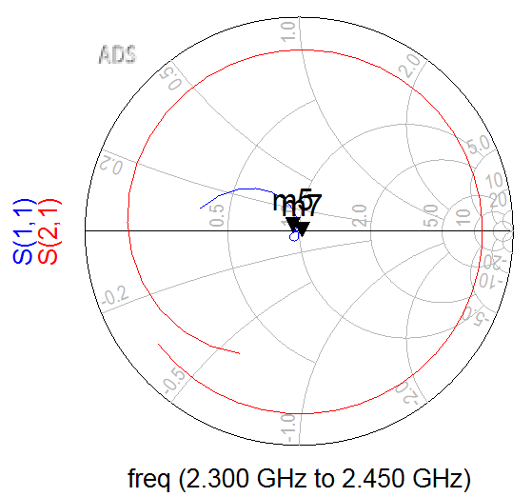
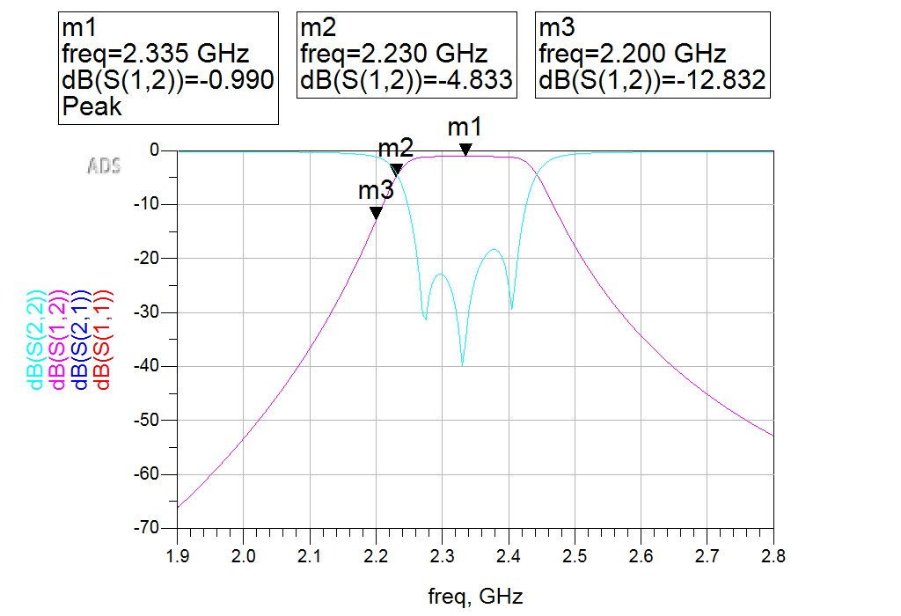
Coupled-Line Bandpass Filter
2.3-2.5 GHz
Butterworth
6th Order
Double-Stub Impedance Matching
Measured f_{c} = 2.39 GHz
Measured Attenuation:
SXM-8 Frequency: 3.51 dB @ 3.2321 GHz
Channel 1 Wi-Fi: 3.42 dB @ 2.415 GHz
Peak DB: 2.59 dB @ 2.39 GHz

Slide 13
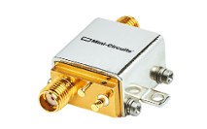
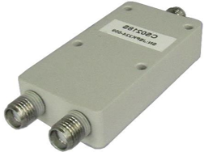
Phase Shift, Combiner, and LNA
Phase Shift Transmission Lines:
From last MTGS group
Centric RF Commercial Combiner:
+/- 5 deg. Phase Balance
+/- 0.3 dB Amplitude Balance
Mini-Circuits Low Noise Amplifier:
5V – 0.101 mA
9 dB Gain – 0.5 dB Noise Figure
Output Power: 23.55 dBm

Slide 14
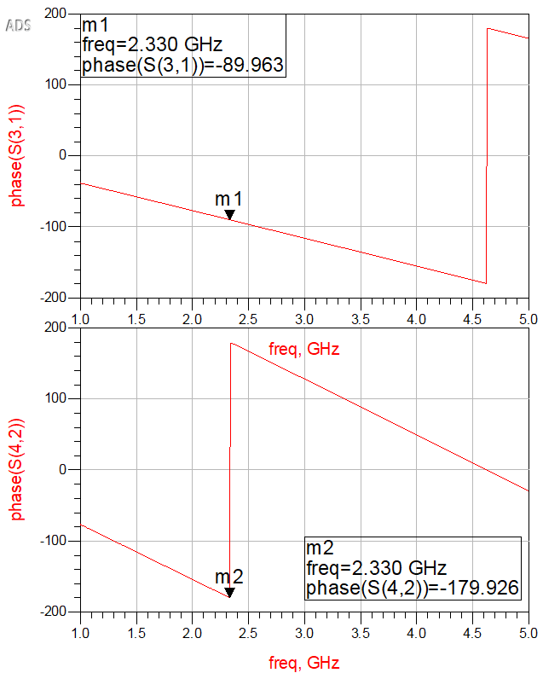
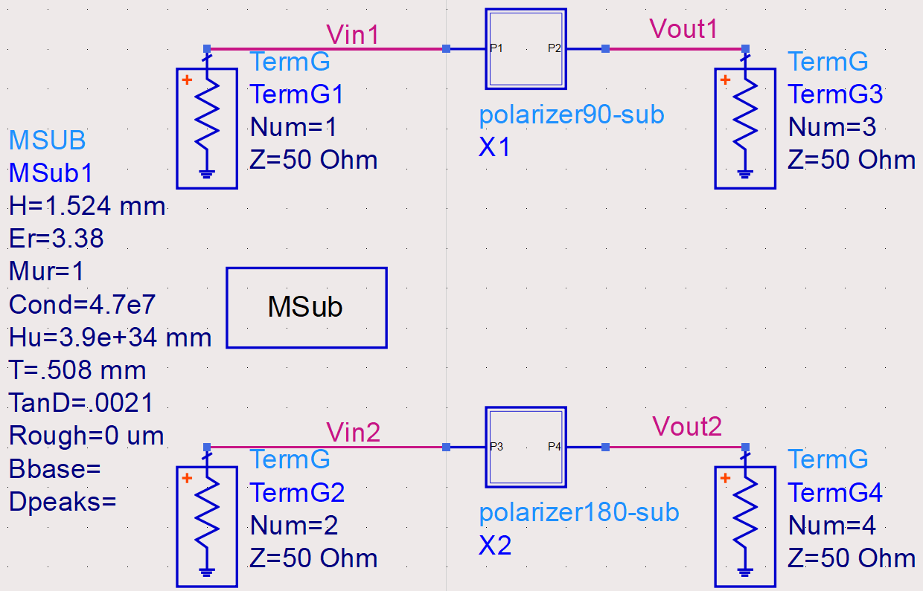
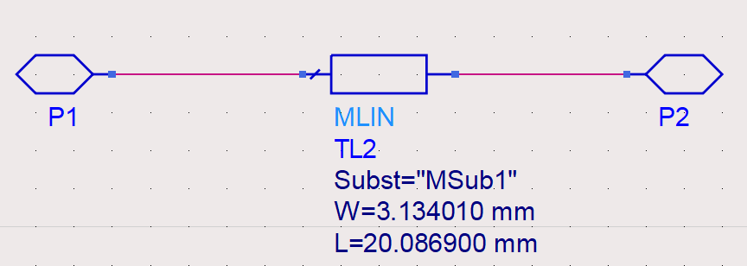
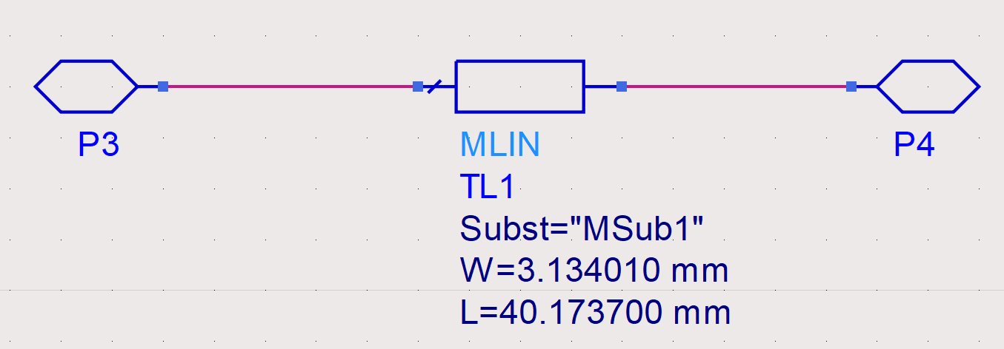
Microstrip Phase Polarization
1
3
4
2
Phase(S(3,1)) @ 2.33 GHz → -89.963°
Phase(S(4,2)) @ 2.33 GHz → -179.926°
-179.926° - (-89.963°)
✔ = -89.963° (= ±90°±1°)

Slide 15
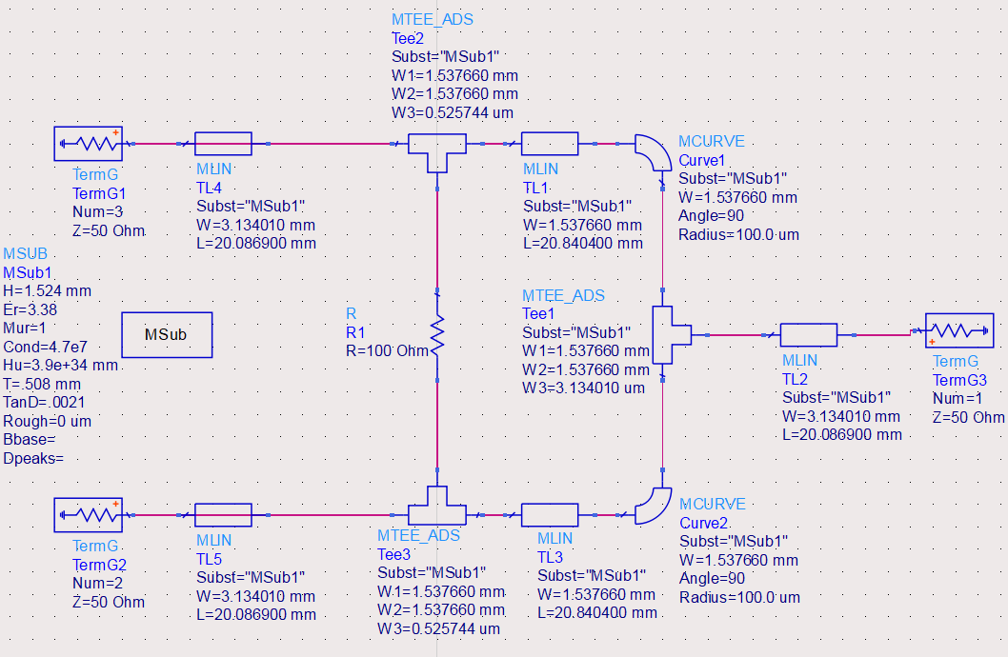
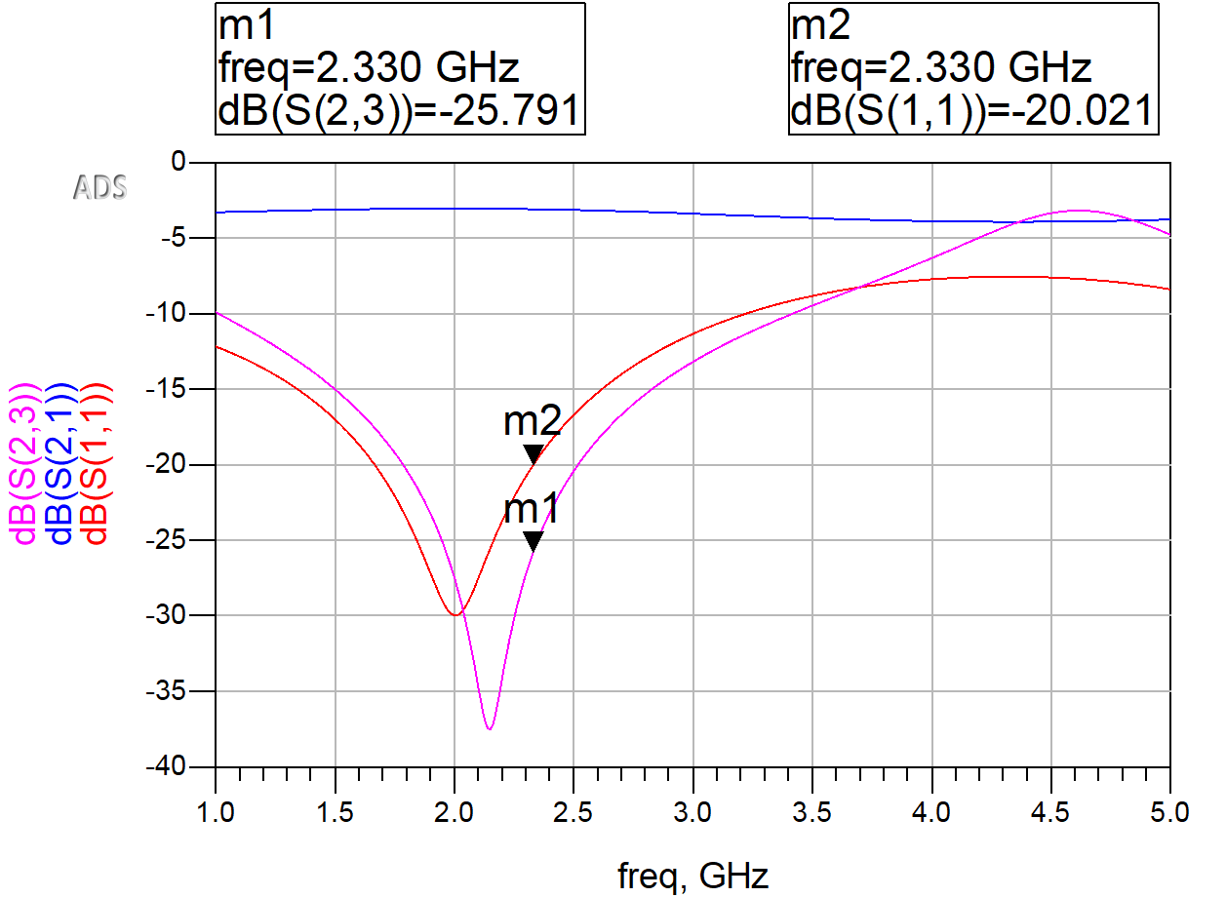
Wilkinson Power Combiner:
✔ dB(S(1,1)) @ 2.33 GHz → -20.021 dB < -20 dB)
✔ dB(S(2,3)) @ 2.33 GHz → -25.791 dB < -20 dB)
3
1
2

Slide 16
Link Budget Analysis
Key variables: TX & RX powers, gains, losses, and noise figures.
P_{rx} = P_{tx} + G_{tx} + G_{rx} - L_{tx} - L_{rx} - L_{fs}
Transmit Power Output: 12.5 dBW
Transmitter Antenna Gain: 23.07 dBi
Transmitter Loss: 0.2 dB
Frequency = 2.3231 GHz, Distance = ~36,750 km
Misc Loss: ~8 dB (Connections and component attenuations)
Receiver Antenna Gain: 24 dBi
Receiver Loss: 15 dB
Received Power: -117.4 dBm *prior to amplification
*Link budget gives us a figure for expected power received after RF block, and in the future could be used to modify some vars for better performance

Slide 17
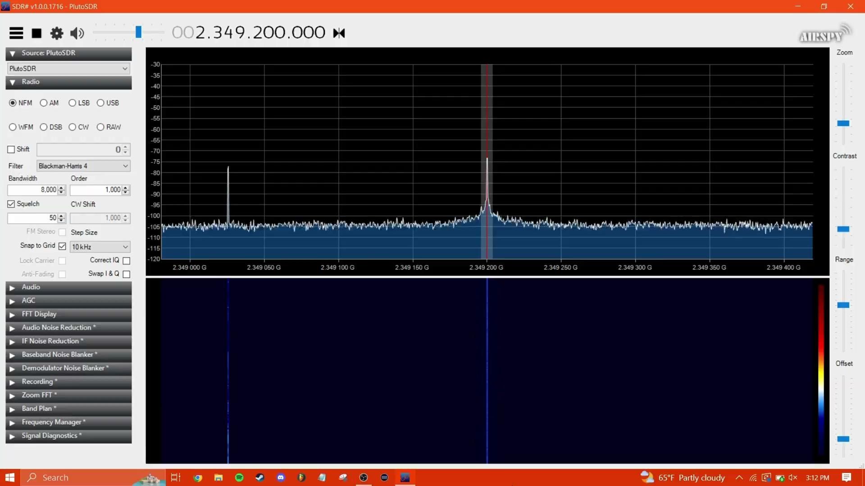
Testing and Validation
In-lab signal testing using signal generator
Confirmed reception of self-made signal
Validated functionality of RF chain
Failed outdoor test to receive SXM-8

Slide 18

Testing and Validation
Tracking software accuracy validated by multiple sources
Full functionality for manual control of positioner
Unable to automate control due to computer controller incompatibility

Slide 19
Customer Needs Satisfaction
RF Chain
SDR works as required
SDR software works as required
Adalm Pluto lacks calibration functionality, resulting in small error with dBFS to dBm conversion
RF block works as required
Unable to receive SXM-8 signal
Better antenna required?
Better RF Block required?
Tracking
Tracking software works as required
Positioner works as required
Positioner controller works as required
Unable to communicate with computer controller
Different computer controller or computer required
Generally, subsystems worked on their own
Failure when integrated

Slide 20
Lessons Learned
Verify datasheet consistency
Plan for budget changes
Check hardware and software compatibility as soon as possible
Plan for non-ideal conditions and parameters
Demodulation is an extensive task and will take considerable research to do

Slide 21
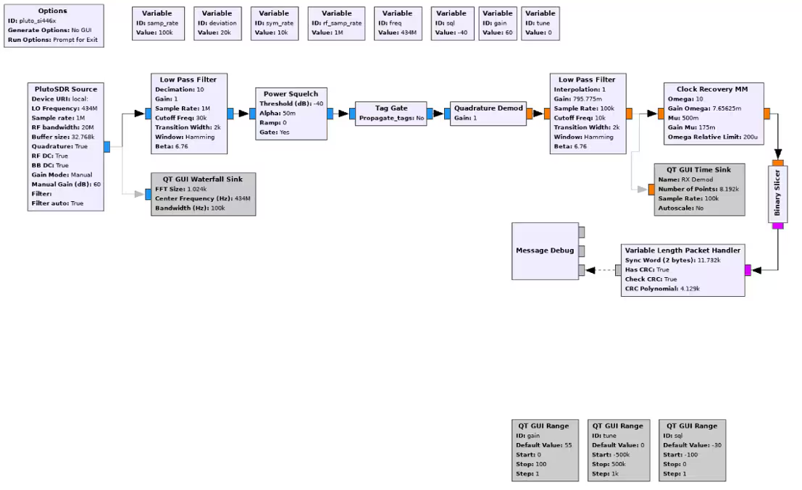
Next Steps
GNU Radio Demodulation
RF waveform to digital data conversion
Design dependent on satellite modulation
Essential for practical application of ground station.

Slide 22
Next Steps
Demodulation on recorded signal, then live demodulation
Upgrade to modern computer controller with compatibility
Long duration tracking tests
Higher gain antenna
Tracking non GEO sats
Newer/more compatible SDR + a wider tuning range

Slide 23
Thank you! Any questions?

